Slide 1
User research results
Group 6
Nina Marie Wahl Carl Emil Hattestad Armelle Rivière Aleksi O’Connor Anna Bellika Kjæmpenes

Slide 2
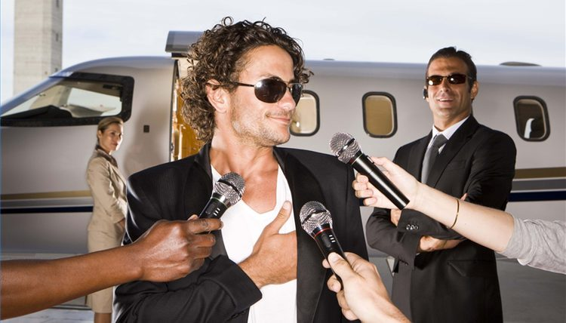

User research methodologies
Semi-structured interviews conducted outside Alameda, metro of Lisbon
Observation of the users in the metro of Lisbon
Observation of the users in the metro of Porto
Notes:
Direct field research, quick and dirty.

Slide 3
Research questions
What kind of feelings does it raise when people see somebody travelling without a ticket?
What motivates people to pay for the metro ticket?
How do people handle their travel cards in proximity of the validation machines and barriers?

Slide 4
Interview questions
Why do you pay for your tickets?
What do you think of people that don’t pay?
How often do you use the metro without paying?
Describe the validating process in one word?
How would our proposed concept affect your motivation for travelling with a valid ticket?

Slide 5
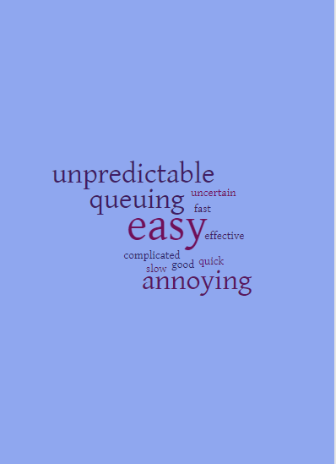
Interviews in Lisbon
21 people
Mostly young people
Outside Alameda metro
At Thursday and Sunday

Slide 6
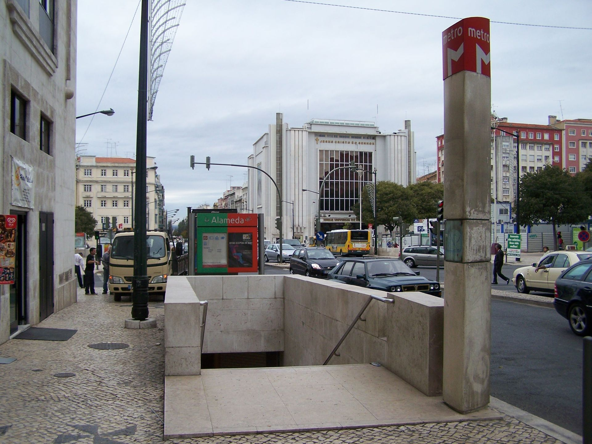
Interviews in Lisbon
People that don’t pay, can’t pay
Most people don’t care if people pay, however some really dislike it
The two people that have traveled without a ticket, says they would pay with our idea
The people that always pays, is unsure if our idea would have an impact on the people that don’t pays

Slide 7
Observations
How frequently does people have problems with validating their tickets?
Where do people store their travel cards after validating their ticket?
How often are there bottlenecks in the metro of Lisbon caused by barriers?

Slide 8
Observing in Lisbon
60 min, different time of the day, different location
Easy access to cards, bag or pocket
People traveling without a ticket often young people
Bottlenecks
Observing and taking notes helps to prevent cheating
Problems concerning our idea
Several cards
Caring cards to high

Slide 9
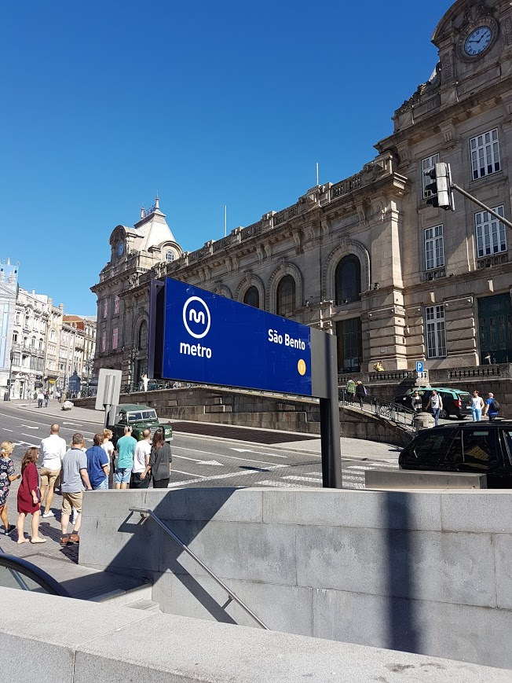
Observing in Porto
One ticket machine → Queue!
Mostly tourists → Buy ticket
All non-buying customers (at machine) → not validating
Easier to skip the tickets than in Lisbon
Shorter observation time

